Slide 1
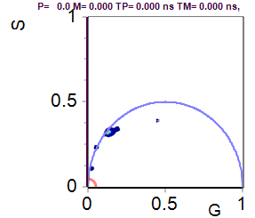
NEW Data from June 2020 (1st and 2nd harmonics, new flim box)
PA14 phz knockout
Colony biofilms
3 days in M9 succinate plates
All phz ko M9 data points (N=33) lie in the phaser between PVD and hydroxy-phenazine.
So with just this data, it appears as if hydroxy-phenazine and pyocyanin are in the phz ko culture.
But really, the culture signal is likely coming from PVD and/or enzyme-bound NADH.
Things like pH affects fluorescence lifetime, so I wouldn’t be surprised if the lifetime of PVD in an actual culture is shifted, but we don’t have any data to prove this.
SimFCS plot. (1st harmonics)
M9 media background
3 plates, depths 0-1000 µM
N=33 images
PVD
OH-Phz
PYO

Slide 2
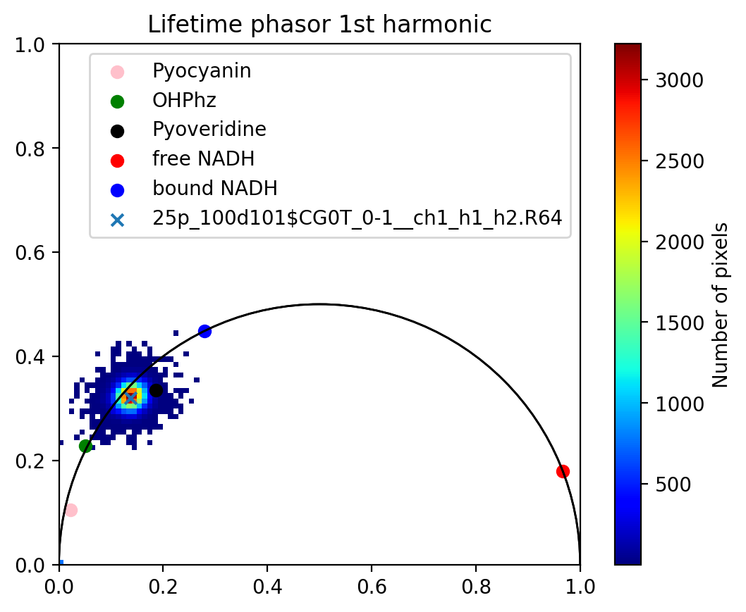
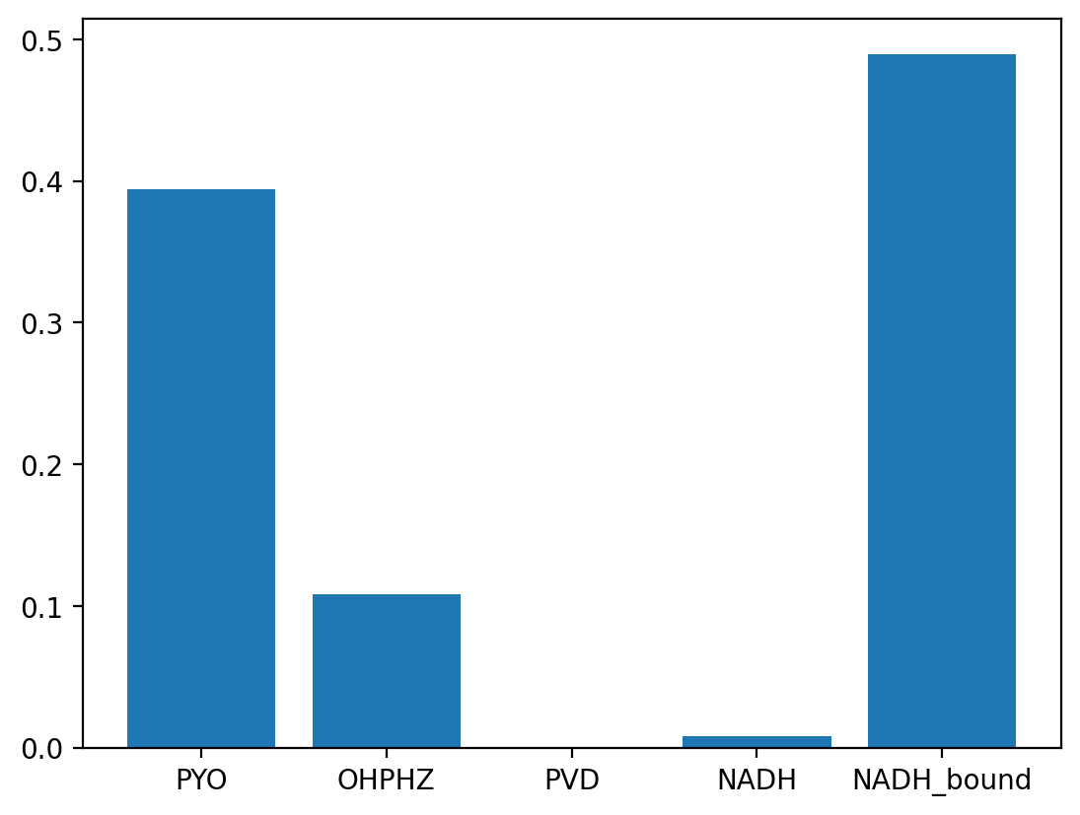
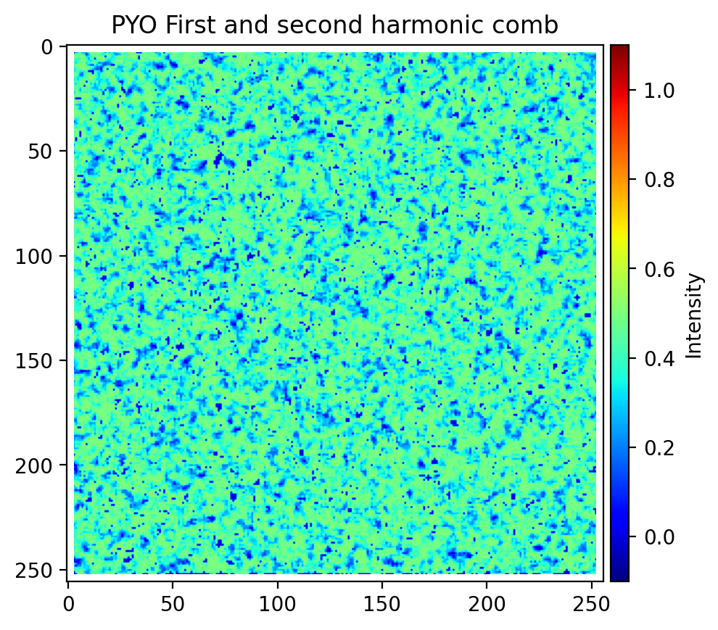
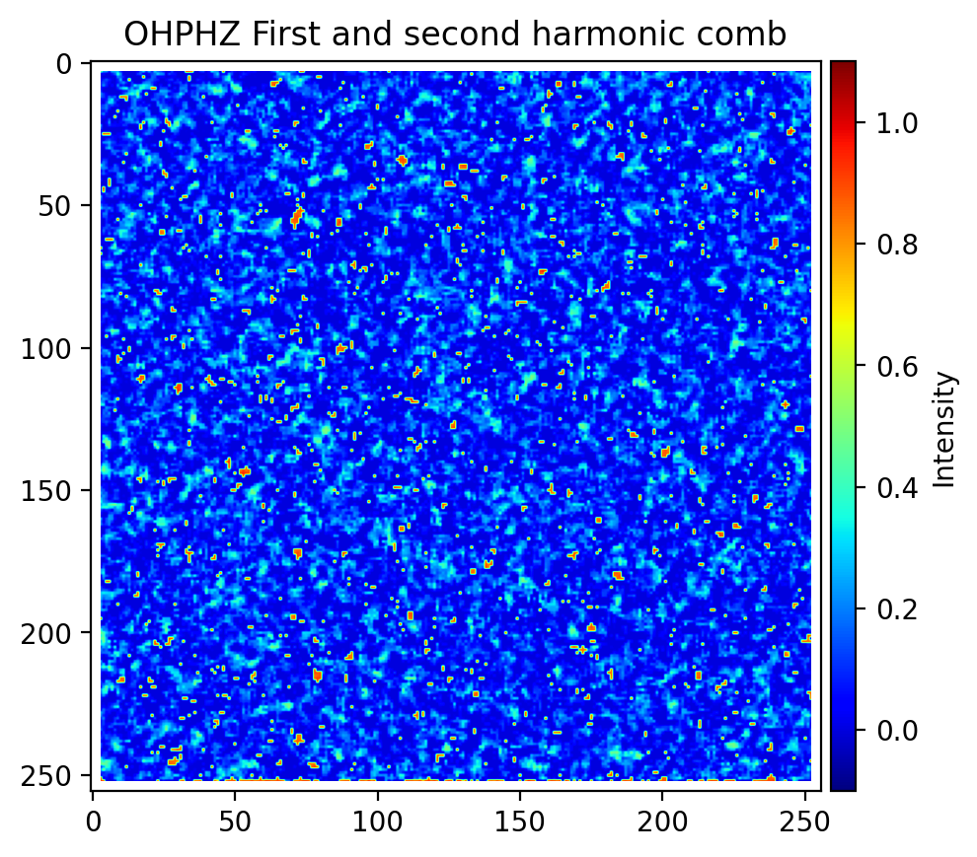
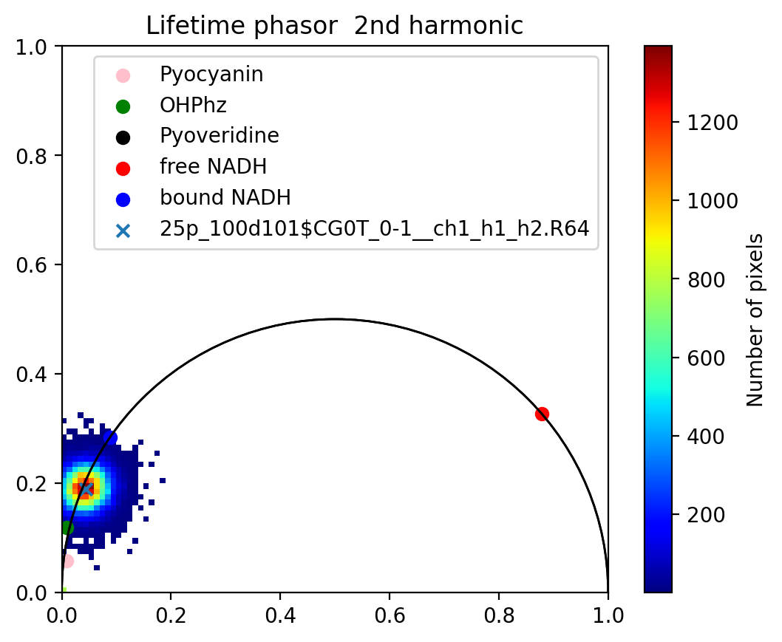
Unmixing algorithm - Input is 1st and 2nd harmonics. With both harmonics, there are more knowns than unknowns and the system can be solved (in theory) - phz ko biofilms in M9 succinate plates
Phz ko M9 Phasors:
Phz ko M9 Fractional contribution results:
Signal is being annotated as pyo and Oh-Phz by the FC algorithm! But I think its just pyoverdine with a lifetime that is slightly shifted in culture from the dye.

Slide 3
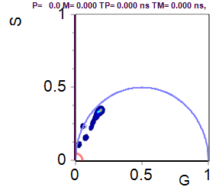
NEW Data from June 2020 (1st and 2nd harmonics, new flim box)
WT PA14
Colony biofilms
3 days in M9 succinate plates
See same long lifetime signal at surface of biofilm, as ASM plate cultures
Note, we don’t see this depth-dependent trend with phz ko in ASM or M9 succinate, which further supports it’s from a phenazine
SimFCS plot. (1st harmonics)
3 plates, depths 0-1000 µM
N=33 images
Shifts w/ depth
PVD
Oh-phz
Surface of biofilm!
PYO

Slide 4
Manuscript
I don’t think we should include the fractional contribution results (from Simon’s algorithm), since the phz knockout M9 plates data suggests those results are an inaccurate representation of the fluorophores that are actually present.
Instead, this manuscript can focus more on the initial characterization of Pa fluorophores and the one result that I’m confident in: lifetime shift with biofilm depth / pyocyanin reduction.
Future papers could identify all fluorophores in the Pa cultures, but I think that would involve someone collecting a lot of data on how conditions like pH and redox affect the lifetime of pyocyanin, pyoverdine, and hydroxy phenazine. In the meantime, Simon is still working on the code for the unmixing software (it’s not very usable right now).

Slide 5
Title Ideas:
The fluorescence lifetime of Pseudomonas aeruginosa biofilms shifts with depth and is associated with pyocyanin reduction
Authors:
T. Gallagher, S.W. Leemans, A. Dvornikov, K. Perinbam, J. Fong, C. Kim, J. Kapcia, M. Kagawa, A. Grosvirt-Dramen, A. Hochbaum, M. Digman, E. Gratton, A. Siryaporn, K. Whiteson

Slide 6
Potential journals
ACS Nano Letters
Scope: Experimental and theoretical results on physical, chemical, and biological phenomena at the nanoscale
3,000 words, max of 5 figures
Biomedical Optics Express
Scope: The journal scope encompasses fundamental research, technology development, biomedical studies and clinical applications related to optics, photonics and optical imaging in biomedicine.
https://www.osapublishing.org/submit/style/oestyleguide.cfm

Slide 7
Results outline
Part 1: spectral and flim characterization of phenazines and pyoverdine
Part 2: characterization of WT Pa flim in different media and oxygen conditions
Part 3: WT and phz ko biofilms – depth signal in WT.
Rough drafts of figures in subsequent slides (publication-quality in progress)

Slide 8
1. Characterized Pa fluorophores
Fig 1: Spectral and flim phasors of Pa fluorophores. Characterized the 1st and 2nd harmonic fluorescence lifetimes of all known Pa fluorophores (within the emission filter wavelength limits)
*need to add hydroxy phenazine

Slide 9
1. Characterized Pa fluorophores
Supplemental: Pyocyanin and hydroxy phenazine spectral, lifetime shifts from chemical and electrochemical reduction experiments

Slide 10
2. Characterized Pa cultures
Supplemental: Compared Pa phaser to other bacteria (Rothia, Steno, Ss)
Fig. 2: FLIM of Pa cultures in ASM, M9 glucose, pyruvate, succinate (aerobic, hypoxic)

Slide 11
3. Characterized Pa biofilms
Fig. 3: WT and phz ko biofilms in ASM, M9 succinate
3a: compare means of WT to phz ko (need to make)
3b: show WT depth trend towards PYO

